Slide 1

One fund.
Many benefits.
Investments are not FDIC-insured, nor are they deposits of or guaranteed by a bank or any other entity, so they may lose value.
RPGEPO-107-0725O CGD/TM/9768-S109398
© 2025 Capital Group. All rights reserved.
Notes:
Good [morning/afternoon].
My name is [name], and I’m a [title] with [firm’s name].
Your employer has asked me to talk with you about saving for retirement with target date funds.
I’m excited to tell you about target date funds and the benefits of investing in one. Let’s get started.
[CLICK]

Slide 2
“To plant a garden is to believe in tomorrow.”
Audrey Hepburn
Actress and humanitarian
Notes:
Actress and humanitarian Audrey Hepburn once said: “To plant a garden is to believe in tomorrow.”
Much like planting a garden, you have to plan ahead for retirement — and the earlier you start, the better your potential for success.
But with just 21% of American workers feeling very confident that they’ll have enough money in retirement (according to the Employee Benefit Research Institute’s 2024 Retirement Confidence Survey published April 25, 2024), most of us could use some help planning for tomorrow.
[CLICK]

Slide 3
Choosing a single target date fund helps:
Make investing for retirement easier
Take uncertainty out of choosing investments
Notes:
Today, I want to share three reasons target date funds can make investing for retirement easy.
First reason: Target date funds simplify the process of investing for retirement because you don’t have to choose a variety of different investments. To give you an example, your employer has selected the American Funds Target Date Retirement Series for your plan. Each of these target date funds contain a broad mix of investments that were selected by the Capital Group Target Date Solutions Committee, a group of experienced investment professionals who also actively monitor each fund.
Each target date fund is made up of a broad range of investments and designed to meet your changing financial needs over time, so you can choose a single fund as your overall portfolio.
Target date funds are designed to help you invest for retirement now and generate income later with just one easy-to-use portfolio.
[CLICK]

Slide 4
A target date fund is …
… designed to be
the only investment you need
Notes:
Second reason: A target date fund is designed to be the only investment you need.
That’s because the investment mix changes from a more growth-oriented focus to a more income-oriented focus as the fund gets closer to its target date. This means you don’t have to worry about changing your investment strategy as long as your anticipated retirement date stays the same.
[CLICK]

Slide 5
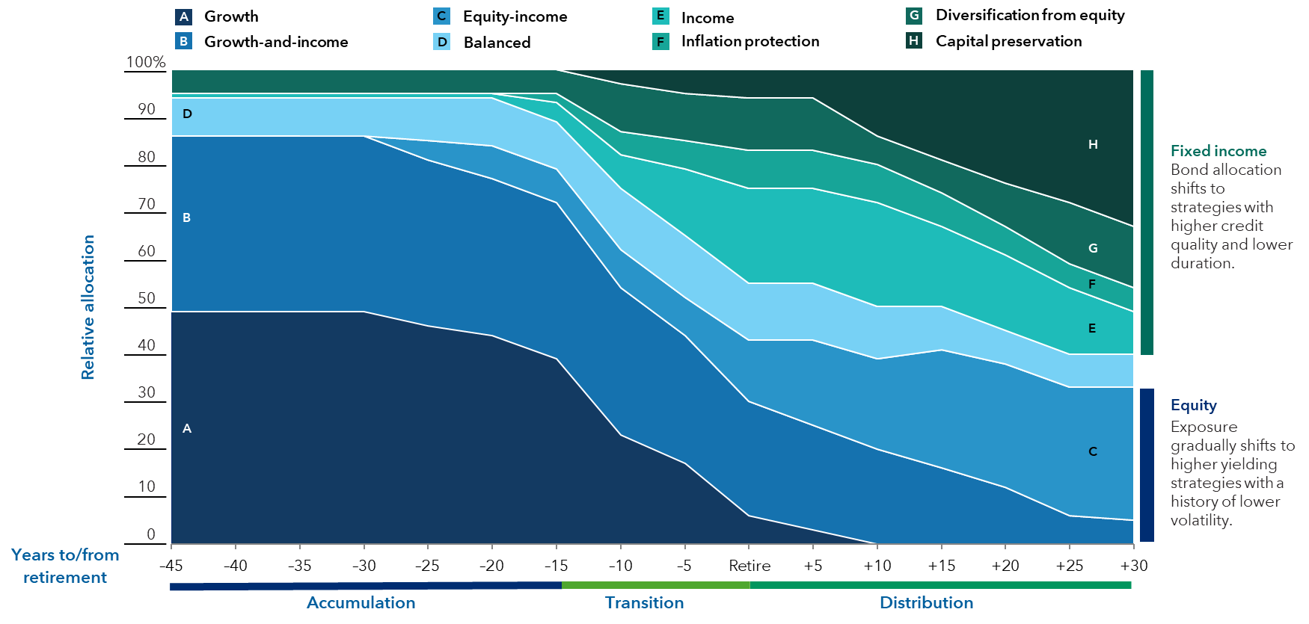
An investment mix that changes over time
American Funds’ objective-based glide path
Although the target date portfolios are managed for investors on a projected retirement date time frame, the allocation strategy does not guarantee that investors’ retirement goals will be met. Investment professionals manage the portfolio, moving it from a more growth-oriented strategy to a more income-oriented focus as the target date gets closer. The target date is the year that corresponds roughly to the year in which an investor is assumed to retire and begin taking withdrawals. Investment professionals continue to manage each portfolio for approximately 30 years after it reaches its target date.
The target allocations shown are as of March 31, 2025, and are subject to the oversight committee’s discretion. The investment adviser anticipates assets will be invested within a range that deviates no more than 10% above or below the allocations shown in the prospectus/characteristics statement. Underlying funds may be added or removed during the year. Refer to capitalgroup.com for current allocations.
Notes:
This chart, which is called a glide path, helps show how the investments in a target date fund change over time:
[CLICK]
Moving from left to right, you see that stocks play a larger role in each fund objectives makeup or mix when the target retirement date is years away. That’s because stocks have potential for higher returns, but they’re also more vulnerable to market declines.
[CLICK]
As you continue toward the target retirement date, which is the year that corresponds roughly to the year you intend to retire and begin taking withdrawals, the mix gradually shifts to include more bonds, which tend to rise and fall less dramatically than stocks, but typically don’t offer as much potential for growth.
This approach helps emphasize investment growth when you’re younger — when your investments can take on more market risk because you have time on your side — and this approach can help reduce the impact of market declines as you near retirement and start preparing to take retirement withdrawals.
[CLICK]
The funds in the American Funds Target Date Retirement Series are also managed for approximately
30 years beyond the target retirement date. So the allocation to bonds continues to increase through
retirement, which can help provide a measure of protection during stock market declines.
[CLICK]

Slide 6
It’s easy to get started:
Choose the fund that corresponds roughly to the year you plan to retire
Notes:
Third reason: Getting started with a target date fund is easy because you simply choose the fund that corresponds roughly to the year you plan to retire.
Let me show you an example.
[CLICK]

Slide 7
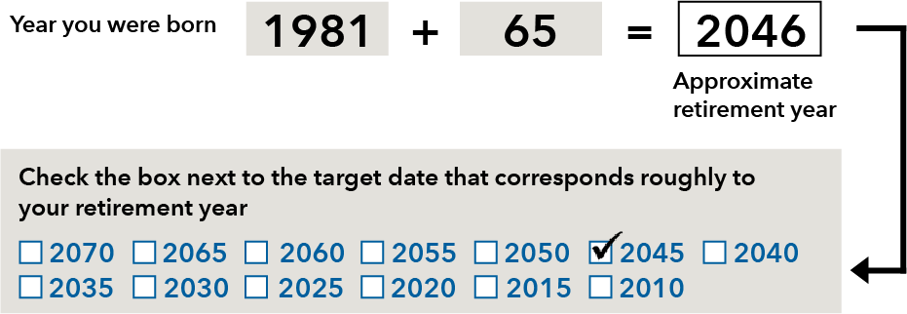
Choosing your target date fund is easy
When do you plan to retire?
Notes:
[CLICK]
First is your birth year. Let’s use 1981 as an example.
[CLICK]
Then determine what age you expect to retire. This is age 65 for many investors, but may be different for you.
[CLICK]
Add your birth year and the age you plan to retire to get your approximate retirement year.
In this example, that would be 2046.
[CLICK]
Then choose the target date fund that corresponds roughly to your retirement year.
That’s it! You just chose your target date fund. As we saw earlier, that single fund choice gives you a broad mix of investments that changes over time to help you pursue your retirement goals. Plus, investment professionals continue to manage each portfolio for approximately 30 years after it reaches its target date.
[CLICK]

Slide 8
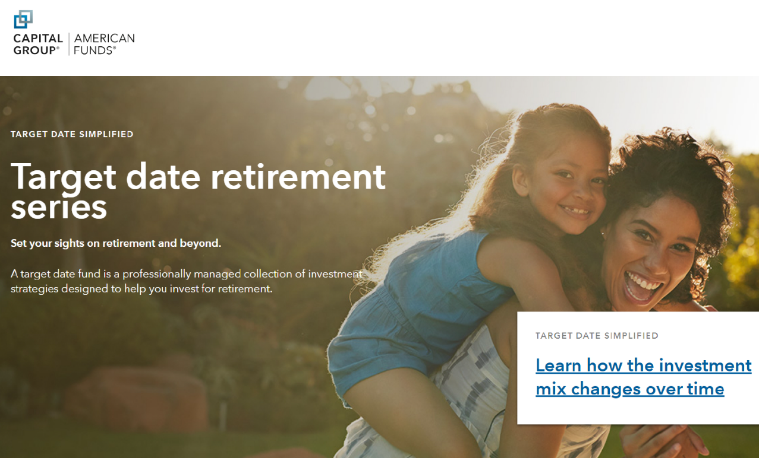
Learn more at targetdatesimplified.com
Investor education
Fund selection
Detailed fund information
Notes:
You can learn more about the things that we covered today by visiting targetdatesimplified.com.
You’ll find a video that helps explain target date funds in a fun and easy-to-understand way.
There’s also a fund selection tool to help you find the target date fund that's most closely aligned to the year you expect to retire.
Once you’ve determined your fund, you can see its glide path, asset mix and underlying funds.
[CLICK]

Slide 9
The Capital Advantage®
Pursuing superior investment outcomes for
more than 90 years
Many investment management fees are low*
A seasoned group of investment professionals
monitors the series†
*On average, our mutual fund management fees were in the lowest quintile 49% of the time based on the 20-year period ended December 31, 2024, versus comparable Lipper categories, excluding funds of funds.
† Members of the Target Date Solutions Committee average 29 years of investment industry experience as of December 31, 2024.
Notes:
Not every mutual fund company or target date series is created equal. Let’s talk about just a few things that help set Capital Group and the American Funds Target Date Retirement Series apart from the rest.
[CLICK]
Capital Group is the manager of one of the nation’s largest mutual fund families. For more than 90 years, the firm has been pursuing superior outcomes for long-term investors like you.
[CLICK]
Capital Group recognizes that costs can hurt your retirement investment over time; that’s one reason why it’s committed to low fees.
[CLICK]
Funds in the series are monitored by the Target Date Solutions Committee, a team of seasoned investment professionals with diverse backgrounds.
With an average of 29 years of investment industry experience (as of December 31, 2024), the team reviews and adjusts the investment mix of each target date fund.
[CLICK]

Slide 10

Start today.
Plant a
seed for
retirement.
© 2025 Capital Group. All rights reserved.
10
Notes:
Now it’s time for you to plant a seed for your future by saving for retirement.
As you’ve seen today, the American Funds Target Date Retirement Series makes it easy to get started:
The Series takes the uncertainty out of choosing investments. With a single fund, you actually get a wide range of investments to help balance market risk and growth.
With a diverse investment mix that automatically changes over time, a target date fund is designed to be the only retirement investment you need.
It’s easy to choose your fund based on your approximate retirement year.
Capital Group emphasizes professional investment management and has a commitment to low fees.
For more information about American Funds target date funds, please visit your plan’s website or contact your human resources representative.
[CLICK]

Slide 11
Important information
Investors should carefully consider investment objectives, risks, charges and expenses. This and other important information is contained in the fund prospectuses and summary prospectuses, which can be obtained from a financial professional and should be read carefully before investing.
Notes:
[Note to financial professional: Please refer to slide.]

Slide 12
Important information
This content, developed by Capital Group, home of American Funds, should not be used as a primary basis for investment decisions and is not intended to serve as impartial investment or fiduciary advice.
All Capital Group trademarks mentioned are owned by The Capital Group Companies, Inc., an affiliated company or fund. All other company and product names mentioned are the property of their respective companies.
Capital Client Group, Inc.
Notes:
[Note to financial professional: Please refer to slide.]

Slide 13
One fund.
Many benefits.
RPGEPO-107-0725O CGD/TM/9768-S109398
© 2025 Capital Group. All rights reserved.
Notes:
[Note to financial professional: Thank employees for attending, take any questions they have and let them know how to get in touch with you if they need further assistance.]
I’d be happy to take any questions at this point.
[CLICK]

