Slide 1


Winds of change
Open-source financial literacy program
Investments are not FDIC-insured, nor are they deposits of or guaranteed by a bank or any other entity, so they may lose value.
RPGEPO-210-0525O 9638-S108824
© 2025 Capital Group. All rights reserved.
Notes:
[CLICK]

Slide 2

The wind is always blowing …
© 2025 Capital Group. All rights reserved.
2
Notes:
Isn’t it amazing how some aspects of day-to-day life are obvious one minute, barely palpable the next, but never actually disappearing? Take the wind for example …
[CLICK]

Slide 3

That wind can work against you …
Not on eDAM
© 2025 Capital Group. All rights reserved.
3
Notes:
Some days, you would give your right arm for the slightest breeze. Others, you might cower in a storm cellar while the wind blows your house down above you.
But it’s always going to be there, even when you’re trying to ignore it.
[CLICK]

Slide 4

Or can the wind work for you?
© 2025 Capital Group. All rights reserved.
4
Notes:
But what if you built a windmill? Now, the wind is not some random force sweeping over you. It’s a resource. It’s a source of energy — electrical energy these days, but farmers used to use them to pump water or grind grain.
All of this force and energy that used to just sweep by you has become a tool you’re using to achieve other goals.
You’ve taken something that was an inescapable fact of life and harnessed it to your benefit. This power to harness that wind has revolutionized industries past, present and future, and it’s with that same phenomenon in mind we ask: How can we harness time?
[CLICK]

Slide 5

The clock is always ticking …
j
Not on eDAM
© 2025 Capital Group. All rights reserved.
5
Notes:
Time is like the wind, in that sense. Whether you’re doing anything with it or not, it keeps flowing along.
[CLICK]

Slide 6

Time can work against you …
Not on eDAM
© 2025 Capital Group. All rights reserved.
6
Notes:
Ask your parents how they feel in the morning, and the answer may be much like this car, but in human form. Time can take its toll!
[CLICK]

Slide 7

Or time can work for you …
j
Not on eDAM
© 2025 Capital Group. All rights reserved.
7
Notes:
Time can also work for you. Plant a tiny little seed and leave it alone, and you could wind up with a tree. And many believe that a well-cared-for antique violin has a deeper and richer sound than a brand-new instrument.
Let’s take this metaphor a step further. Imagine that the economic forces of our society are like the wind. They swirl around you, flowing past you, sometimes in ways you can easily ignore, others in ways that dominate your life.
And in that case, investing is the equivalent of building that windmill. Once you put it up, you just wait, and the forces of nature can potentially do all the work for you. It’s a “time turbine,” if you will …
[CLICK]

Slide 8

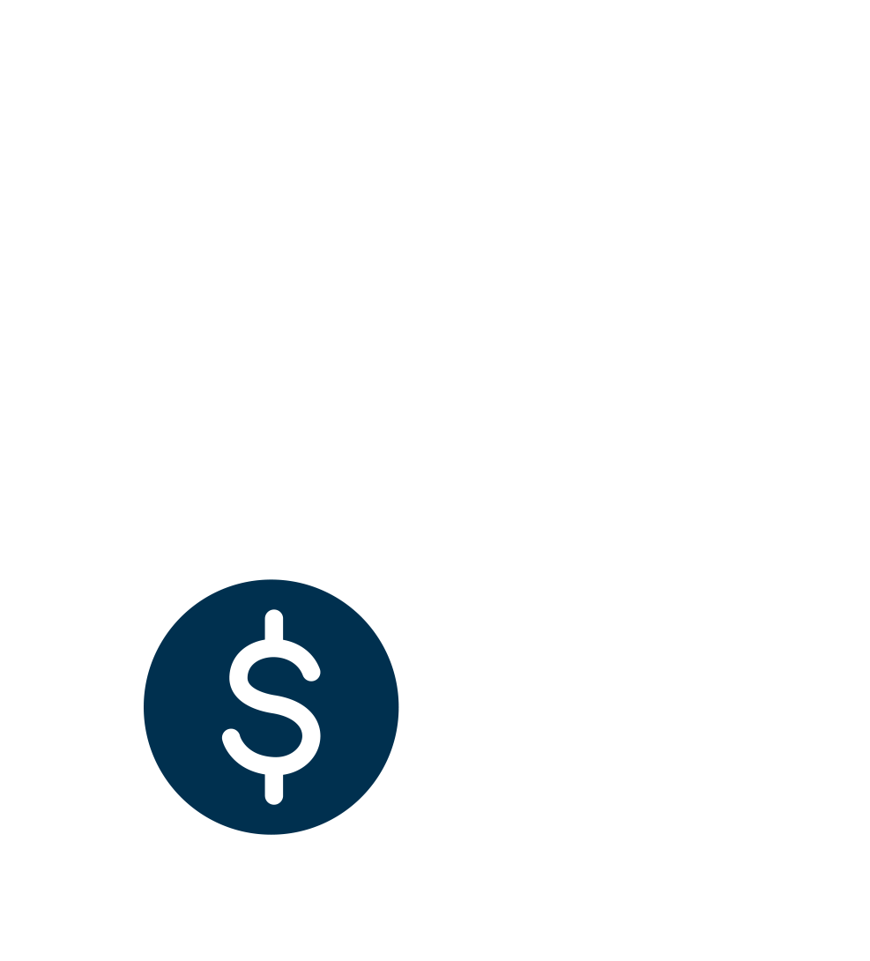
The “time turbine”
“Compound interest is the
eighth wonder of the world.
He who understands it, earns it ... He who doesn’t ... pays it.”
— Albert Einstein
Notes:
To understand how investing works like a time turbine, a windmill to capture economic power, the key concept is compounding — either in the form of compound interest or compound returns from an investment.
As Einstein reportedly put it: “Compound interest is the eighth wonder of the world. He who understands it, earns it ... He who doesn't ... pays it.”
[CLICK]

Slide 9
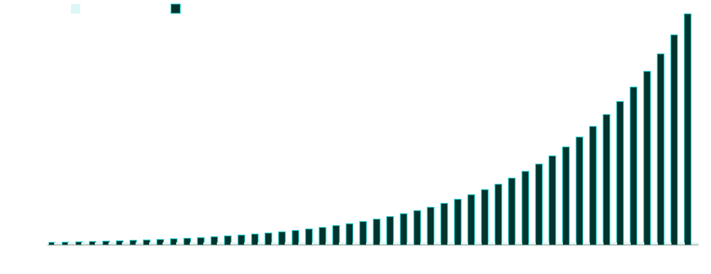
Compounding can help grow assets faster
Source: Investor.gov. Displays the hypothetical growth of $10,000 growing at 10% a year, compounded annually. Returns and ending balances are hypothetical and provided for illustrative purposes only and are not intended to provide any assurance or promise of actual returns and outcomes. Returns will be affected by expenses, fees, and taxes in addition to any adjustments to the assumed contribution rates and market return. Higher rates of return involve a higher risk of loss. Actual results may be higher or lower than those shown.
© 2025 Capital Group. All rights reserved.
9
Notes:
Merriam-Webster defines interest as “a charge for borrowed money generally a percentage of the amount borrowed.” Compound interest, however, is “interest computed on the sum of an original principal and accrued interest.”
Those are the three magic words: ”and accrued interest.”
That’s basically saying that each interest payment is added to the total, and then the new interest payment is earned on that new total.
The same principle is in play for investment returns. So, over time, your investment has the potential to produce returns not just on the principal but, in the case of positive returns, on the increased value of the principal as well. It’s like a potential windmill that just keeps spinning faster and faster the longer it’s there.
This might seem like a relatively small thing, but it can be powerful over time. It’s a way to combine money with time to potentially produce more money.
Of course, it’s not that simple in practice. Investments can lose money, and rates of returns vary based on a number of factors, including market conditions.
[CLICK]

Slide 10

Save now? Or save later
Not on eDAM
© 2025 Capital Group. All rights reserved.
10
Notes:
Here’s a question to help illustrate this: For those of you in the audience who are 18, what would you do if you got an extra $10,000 right now?
I would love to hear that most of you immediately think to yourself: “Hey, I should invest it!” But if you did, I wouldn’t be here giving this presentation. No, like basically every teenager since the dawn of time, you’re probably living in the now. After all, you’ll have plenty of time later in life to make up for it, right?
Well, let’s break down this idea that you can just wait until you’re middle-aged to start setting aside money.
[CLICK]

Slide 11
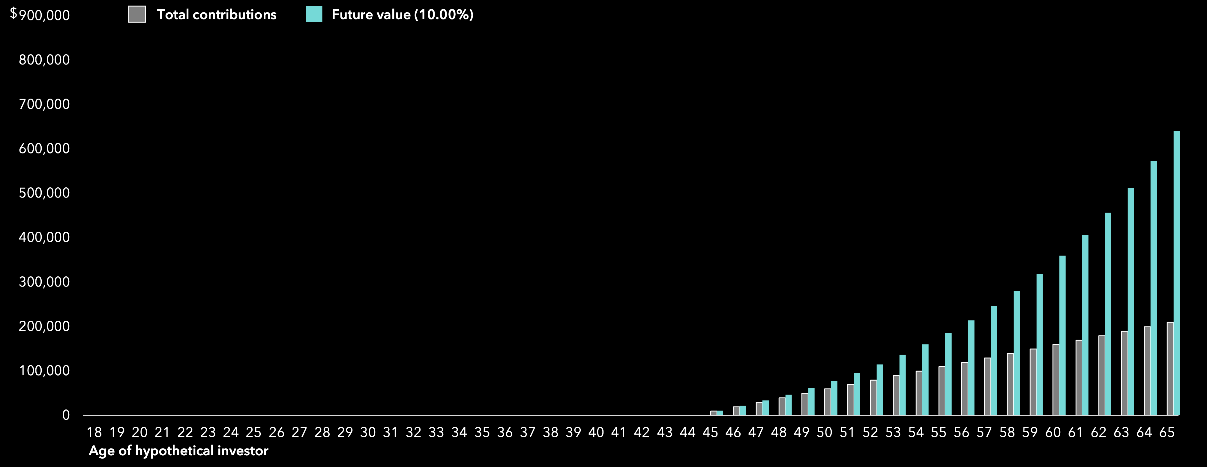
Save later?
10% of $100,000 income from 45 to 65
Source: Investor.gov. Hypothetical illustration. Displays a) value of annual contributions of $10,000 starting at age 45; b) the value of an account receiving an initial investment of $10,000 at age 45, with monthly contributions of $833.33 for 20 years and a growth rate of 10%, compounding annually. Returns and ending balances are hypothetical and provided for illustrative purposes only, and are not intended to provide any assurance or promise of actual returns and outcomes. Returns will be affected by expenses, fees, and taxes in addition to any adjustments to the assumed contribution rates and market return. Higher rates of return involve a higher risk of loss. Actual results may be higher or lower than those shown.
Notes:
Before we display these hypothetical results, let’s re-state that these are just illustrations to help you understand this concept. In the real world, the rate of return and/or interest on an actual investment will vary based on a number of factors, including market conditions, and investors have the potential to lose money. That said, let’s add our two scenarios: [BUILD]
In the first, you spend that $10,000 now and then postpone your investing until you’re 45 and have a great job with an annual salary of $100,000. You set aside 10% of your income every month, so you’re saving that same $10,000 every year for 20 years until you’re 65. This illustration assumes you’re earning a 10% return on your investments.
[CLICK]

Slide 12
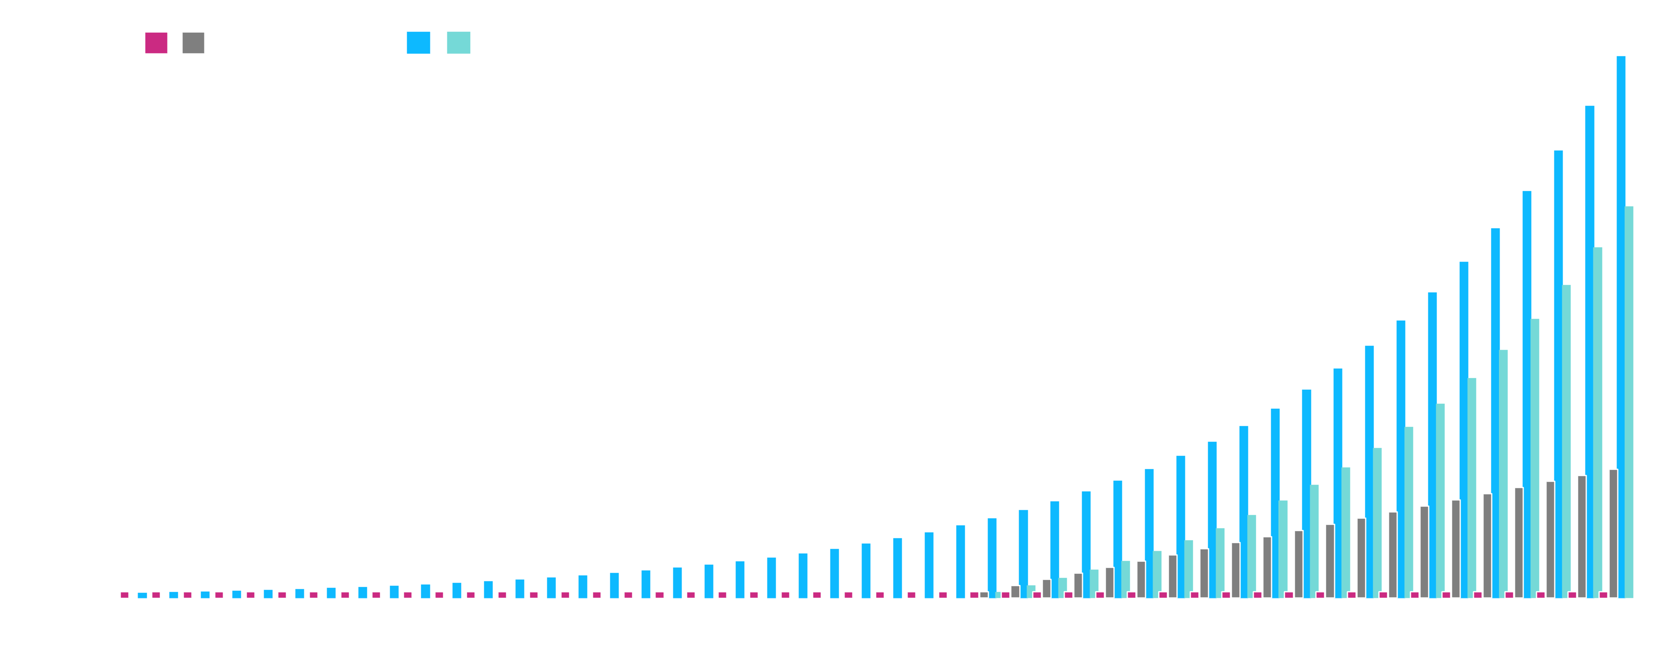
Save later ... or save now?
10% of $100,000 income from 45 to 65
One-time $10,000 investment at 18
Source: Investor.gov. Hypothetical illustration. Displays a) value of annual contributions of $10,000 starting at age 45, or year 27; b) the value of an account receiving an initial investment of $10,000 at year 27, with monthly contributions of $833.33 for 20 years and a growth rate of 10%, compounding annually; c) the value of a single $10,000 contribution at age 18, or year 0; and d) the value of a single $10,000 contribution over 47 years growing at a rate of 10%, compounding annually. Returns and ending balances are hypothetical and provided for illustrative purposes only, and are not intended to provide any assurance or promise of actual returns and outcomes. Returns will be affected by expenses, fees, and taxes in addition to any adjustments to the assumed contribution rates and market return. Higher rates of return involve a higher risk of loss. Actual results may be higher or lower than those shown.
Notes:
Before we display these hypothetical results, let’s re-state that these are just illustrations to help you understand this concept. In the real world, the rate of return and/or interest on an actual investment will vary based on a number of factors, including market conditions, and investors have the potential to lose money. That said, let’s add our two scenarios: [BUILD]
In the first, you spend that $10,000 now and then postpone your investing until you’re 45 and have a great job with an annual salary of $100,000. You set aside 10% of your income every month, so you’re saving that same $10,000 every year for 20 years until you’re 65. This illustration assumes you’re earning a 10% return on your investments.
Your hypothetical $200,000 in contributions more than tripled with a 10% rate of return compounding annually. Not bad! See, your parents were wrong! Spending that money WAS the right idea. But just for a laugh, let’s see what you might have earned if you had invested that $10,000 at age 18, earning that same 10% return compounding annually, and then didn't invest another penny.
Here's that piddling little $10,000 in total contributions, unchanged from year one, and then ...
Wait a second, this is familiar! That hypothetical single $10,000 investment would have turned into about $200,000 more than the first theoretical scenario by the time you turn 65.
To be clear, investing early does not ensure a profit or guarantee against loss, but it may increase the likelihood of a positive investment outcome by giving it more time to grow.
And that’s good, because time is the one thing you probably have plenty of …
[CLICK]

Slide 13

You’ve got nothing but time …
© 2025 Capital Group. All rights reserved.
13
Notes:
That’s because time is on your side. Those of you in this audience right now who are still in your teens have an enormous surplus of the crucial raw material of time.
Why does that matter? After all, you can’t spend time at the Apple Store. I mean, you can; it’s nice there. You just don’t get to leave with any of the stuff unless you also spend money.
But if you really get compound returns, you’ll see how you can take a little money, add some of this time that you’re flush with and potentially earn more money over the long term.
It doesn’t work the other way; just ask your parents. Some of you might have sports cars sitting in your garage at home right now that represent someone trying to spend a lot of money to get back time. It didn’t work.
[CLICK]

Slide 14

Time is money … or money is time?
Not on eDAM
© 2025 Capital Group. All rights reserved.
14
Notes:
Of course, there’s another way to swap time for money that some of you might already be familiar with work. If you need an example: I’m doing it right now.
When you get a job, you’re essentially selling yourself. And what are you getting in return for your physical labor, your mental insight and, let’s face it, your ability to put up with a boss who may not always be your favorite person in the world? Money. You are trading a little slice of your limited time on this earth for money. Holds true for ditch diggers, lawyers, professional athletes and influencers alike.
So maybe the old saying “time is money” should be reversed: “money is time.” In a certain sense, currency itself is just society’s way of storing the value of people’s time as something that can be easily exchanged.
And sure enough, if you want money, you’re almost always going to have to spend some of your time getting it, whether by working or investing.
[CLICK]

Slide 15

Financial independence means the freedom to do what you want with your life
© 2025 Capital Group. All rights reserved.
15
Notes:
What is financial independence? Why is that something you should be thinking about, even at your age? What would it mean to your life? Oftentimes, the financial industry can get a little caught up on “retirement.” And yes, for most people, financial freedom is about being able to stop working. But it doesn’t HAVE to be about that.
Financial freedom is for you to define based on your goals, your wants, your life.
It could mean:
Helping your family
Helping your community
Going (back) to college
Starting a business
Following your true calling
You’ll hear people say things like “it’s just money,” and that’s true. But they also say “time is money,” and that’s also true, as we've seen. If you’re an hourly employee, you’re literally selling your life 60 minutes at a time. If you make $10 an hour, saving up $1,000 is like having 100 hours of your life to “spend” however you want.
So, when it comes to saving and investing, in a way what you’re doing is storing up time — time you might otherwise have to spend earning money.
And in that way, investing is sort of like building a windmill. It’s like having a device that allows time to flow over it, spinning its “turbine” to potentially turn that elapsing time into more money. Its goal is to charge up your wealth batteries over time so that you’ll have that energy to use in whatever way you see fit.
TRANSITION: So here is how we are going to show you the basics of how you can build your own “time turbine” to help you achieve your dreams …
[CLICK]

Slide 16

Putting your money to work
j
p
Not on eDAM
  Invest well
  Know your horizon
  Stay informed
© 2025 Capital Group. All rights reserved.
16
Notes:
So, when it comes to investing, there are three basic things to keep in mind: [BUILD]
Invest well: What you invest in matters.
Know your horizon: When will you want to spend this money? Having a sense of the time frame for your goals will impact what you want to invest in and how.
Stay informed: Keeping up with all of the economic opportunities the world might send your way requires being ready to learn. You’ll never know everything about investing, nobody does, but keeping up with the basics can allow you to get more out of this process.
[CLICK]

Slide 17

A healthy mix called allocation
j
Not on eDAM
© 2025 Capital Group. All rights reserved.
17
Notes:
So, what is meant by “invest well?” A really detailed answer to that question is a multitrillion-dollar industry, but the very basic answer is a bit simpler.
When you’re ready to start investing, it’s time to talk about what investing professionals call “asset allocation.”
If we keep running with our central metaphor, it’s figuring out how many different kinds of windmills we need in order to try to generate the most power in the most efficient way.
[CLICK]

Slide 18

A healthy mix called allocation
Not on eDAM
Stock
Fractional ownership of a corporation. The owner of a stock owns a portion of assets and profits commensurate with the number of shares.
18
Notes:
One well-known option is stocks, which are actually small pieces of different companies. When you buy a stock, you’re becoming one of many part owners of that company.
[CLICK]

Slide 19

A healthy mix called allocation
Not on eDAM
k
Bond
A loan made by an investor to a borrower. A bond could be thought of as an IOU between the lender and borrower that includes the details of the loan and its payments.
19
Notes:
Another very important type of investment is bonds. They are a type of loan, usually to corporations or governments, that allow investors to play the role of lender and earn interest payments and receive the principal, or investment, on the due date.
You’ll often hear the term “fixed income” used when talking about bonds. It describes how bonds typically pay a regular interest payment of a fixed size until the bond reaches maturity and the principal is repaid, provided the issuer doesn’t default on their debt.
[CLICK]

Slide 20
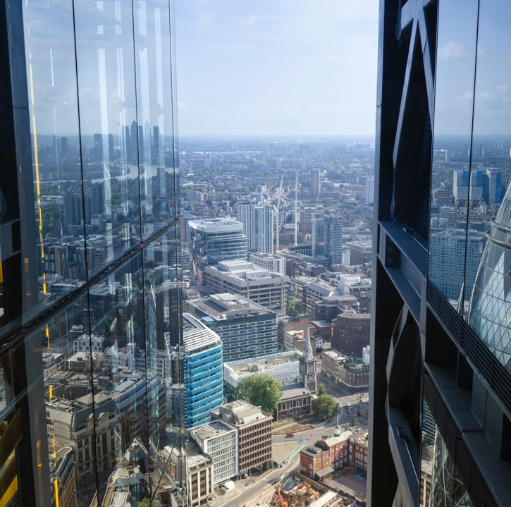
A healthy mix called allocation
Not on eDAM
Fund
Can be a collection of stocks and bonds banded together to create a single, diversified investment product for individual investors.
20
Notes:
Because many people don’t have the training/experience or time to learn which stocks and which bonds are good investments for their needs, they may rely on mutual funds, or their cousins, exchange-traded funds (ETFs).
These funds may invest in multiple different assets and then turn around and sell shares in the fund itself to investors, so each share represents many different investments in many different things — often selected by a team of financial professionals.
If you’re sitting there thinking, “Wow, I can see how important investing is, but I don’t know the first thing about how to do it,” these could be the right fit for you.
And, of course, if you follow the news at all, you’re probably aware that there’s a final category that we might label “other.” Cryptocurrency, options, derivatives, real estate, commodities, fine art, fancy wine, comic books, NFTs (non-fungible tokens), Pokémon cards, etc.
However, there’s a reason why they don’t have their own slide: very, very few people ever manage to have consistent success with those. Of course, there’s no guarantee that any investment will make money or even just avoid losses, but the “other” alternatives may have higher risks and require more sophisticated investment research.
They might make interesting hobbies, might even turn a profit for a lucky few, but relying on “other” for your financial freedom may not work out the way you hope.
[CLICK]

Slide 21

Investment timeline
j
Not on eDAM
When will you need this money?
How much risk are you
willing to take?
Is there an “opportunity cost”?
© 2025 Capital Group. All rights reserved.
21
Notes:
So, not unlike a farmer, you need to plan your harvest date. This would be your time horizon for when you think you might need to start spending your savings. Traditionally, that’s the retirement age of 65, but if you have something different in mind, you’ll want a target date that’s more specific to you and your needs.
One of the major factors impacted by this question is how much risk you’re willing to take. In investing, risk and reward often go hand in hand. Over the long term, you might be ready to take on more risk because you have the time to ride out the ups and downs. But as you get closer to when you’re going to start using that money, it’s usually more important to reduce risk even if it means lower returns. Think of it like taking down the windmills from the areas that have experienced the stronger winds to avoid having to make potential repairs.
So, as we think about our financial independence, let’s consider that timeline and just how long it may be …
[CLICK]

Slide 22

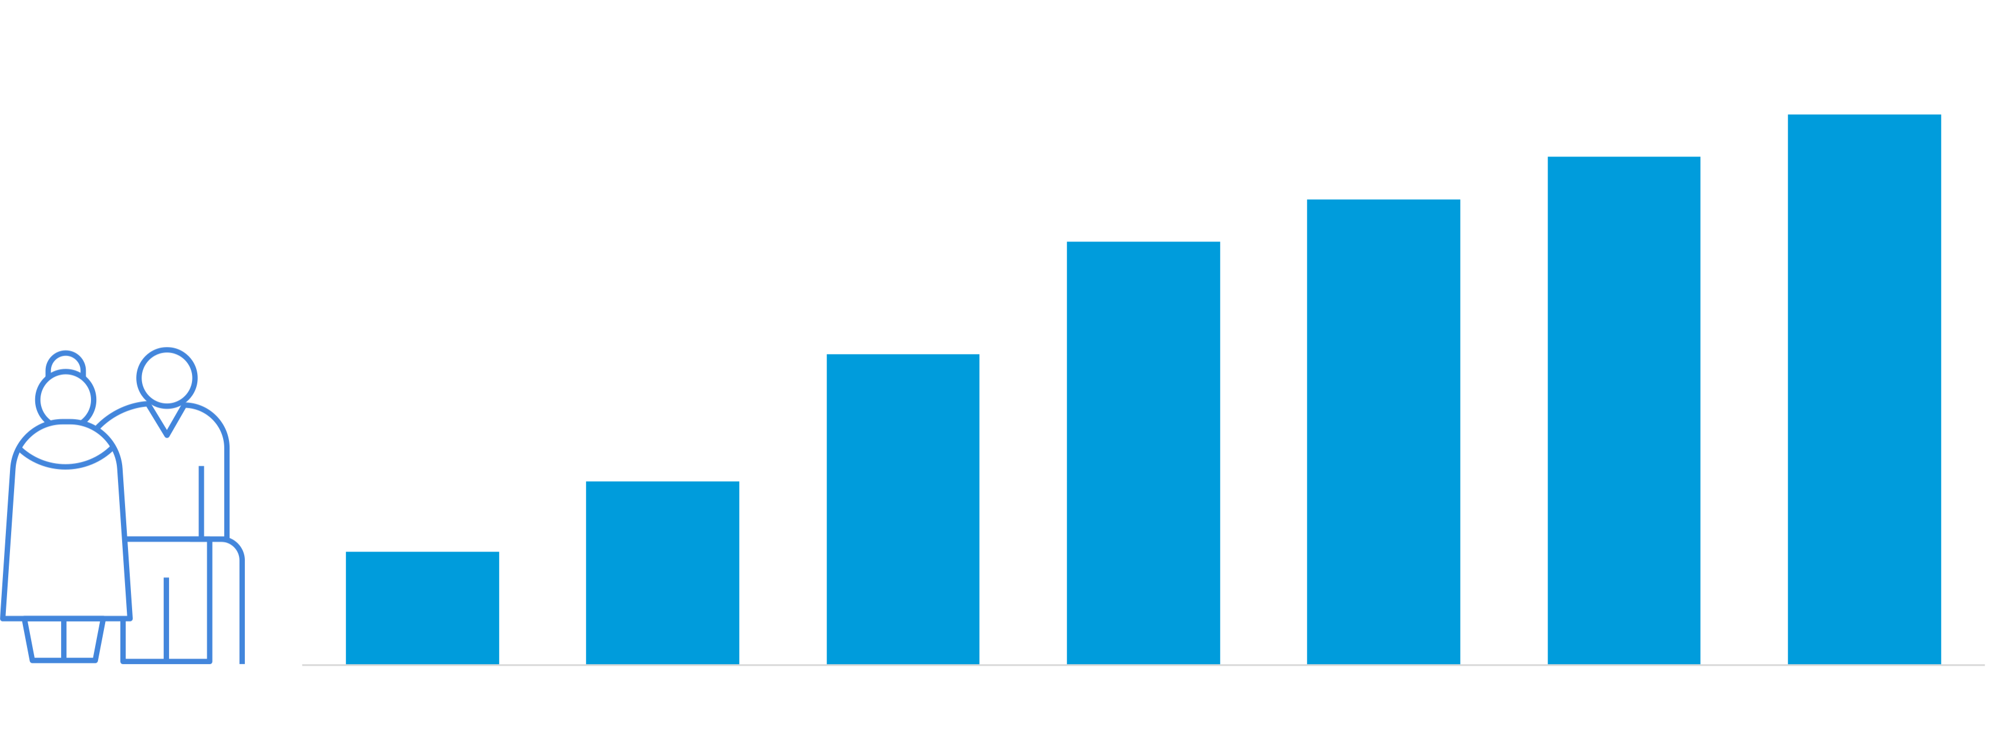
Likely to live a long time, compared to past generations
Source: UN DESA and Gapminder. "Life expectancy (from birth) in the United States, from 1860 to 2020," August 31, 2019. Statista. Accessed June 7, 2024.
© 2025 Capital Group. All rights reserved.
22
Notes:
Congratulations, you have a chance of living for a longer time than the people born in the decades before you. At least, that’s what rising life expectancy would suggest.
More and more, the amount of money you’ll need to retire is probably increasing. But more importantly, the amount of time that you will have to live your best life if and when you achieve financial freedom is also likely to be longer.
[CLICK]

Slide 23

Not likely to get rich quick
Not on eDAM
© 2025 Capital Group. All rights reserved.
23
Notes:
Okay, so reality check: You are probably not going to get rich quick.
[CLICK]

Slide 24



Winning the lottery
Not on eDAM
j
Professional sports
Inheritance
© 2025 Capital Group. All rights reserved.
24
Notes:
That’s right. Let’s start crushing those dreams. Sure, it’s great to aspire to something big, but you are likely not going to win the lottery or sign a multimillion-dollar pro sports contract, and you probably do not have any eccentric great aunts on the verge of leaving their sole living relative their entire estate.
And for the exceptionally rare few who do have that one-in-a-million wealth-creation event, the end results are often not great.
Even if you do get rich quick, your chances of staying rich long are likely pretty limited unless you understand the basics of investing. Without those windmills, the money only flows out, and you could easily end up without all that money, maybe even less than what you started with.
So, if we’re probably not going to hit paydirt, how do we do it? Not overnight but over time …
[CLICK]

Slide 25

The sooner you start, the more time you have
w
What if you start now?
Prior to age 18, you will need a parent / guardian to invest on your behalf
After 18, you can set up an account in your own name
Pay yourself first
Be on the lookout for “time turbines”
  529 accounts
  Investing apps, online brokerages
  Employer-sponsored retirement plans
  Individual retirement accounts (IRAs)
© 2025 Capital Group. All rights reserved.
25
Notes:
If there’s one thing to understand about investing, it’s that time can be a great ally. The more time you can give those windmills to work, the better off you are likely to be. If you're under 18, you can’t legally invest on your own yet, but you can still get started by having your parent/guardian open a custodial account on your behalf.
So how do you do this? The first thing is to pay yourself first. If there’s one good habit you can develop, it’s setting aside a certain portion of your income for your investments, no matter how small it might seem. Depending on what’s going on in your life, determine if you can take 1%, 5% or 10% of your paycheck to put toward your windmills and try to stick to it or even increase it over time.
So where do you put this money? If you are over 18, there are a number of options, including some that may have tax benefits.
Right now, a 529 savings plan is probably something you or your parents have use for. These are accounts typically set up to save for college. Even if you aren’t 18 yet, someone who is can open a 529 in your name.
For those who are 18, there are plenty of investing apps and online brokerages for you to begin your journey as an investor. But if you invest through these services and don't enlist the help of a financial professional, you should consider the substantial research that will be necessary to make informed decisions.
There are also accounts set up specifically for retirement savings. Most people with taxable compensation can open a traditional or Roth individual retirement account (IRA).
And, of course, many people use a retirement plan provided by their employer, usually a 401(k). These have the added benefit of usually allowing you to automatically deduct contributions from your paycheck, ensuring you’ll pay yourself every pay cycle.
The most important thing is getting started: setting that personal paycheck and sticking to it.
[CLICK]

Slide 26

An investment in education
Not on eDAM
© 2025 Capital Group. All rights reserved.
26
Notes:
When it comes to education, investing in yourself can pay dividends!
Getting a college education can be one of the best ways to boost your earning potential, but there are plenty of other ways you can develop skills and talents that might pay off over time.
[CLICK]

Slide 27

Look for answers
Not on eDAM
© 2025 Capital Group. All rights reserved.
27
Notes:
And when it comes to education about investing, the resources you have at your disposal are mind-boggling when compared to past generations.
[CLICK]

Slide 28




Look for answers
Not on eDAM
Web
YouTube, podcasts and social media
Outlets with good reputations and good intentions
Media
Books
Magazine
Newspapers
Family and friends
Six degrees of finance
Internships
Shadow
Notes:
Of course, it may make sense for some investors to work with a financial professional. However, because not everyone can afford a service like this, many will turn to publicly available sources of information to inform their investing.
There are many great options online for learning about investing, and you shouldn’t hesitate to take advantage of them. You can now do research in minutes that used to take weeks, even months.
There are also plenty of options elsewhere in the media, including loads of great books, magazines and, yes, even newspapers dedicated to learning how to invest more confidently.
But while going to these third-party sources can be helpful, don’t overlook the chance to ask questions of friends, family, teachers, coworkers … whomever you can. They may not be experts, but they also might have practical experience dealing with these matters in their own lives. Those are lessons that can often be very valuable.
[CLICK]

Slide 29

Best time to plant a tree …
Not on eDAM
© 2025 Capital Group. All rights reserved.
29
Notes:
An age-old question: When is the best time to plant a tree? The answer: 20 years ago. The second-best time: today.
No matter where you are in the journey toward financial independence, it’s never too early or too late to start building your time turbines.
[CLICK]

Slide 30
Important information
Statements attributed to an individual represent the opinions of that individual as of the date published and do not necessarily reflect the opinions of Capital Group or its affiliates. This information is intended to highlight issues and should not be considered advice, an endorsement or a recommendation.
This content, developed by Capital Group, home of American Funds, should not be used as a primary basis for investment decisions and is not intended to serve as impartial investment or fiduciary advice.
All Capital Group trademarks mentioned are owned by The Capital Group Companies, Inc., an affiliated company or fund. All other company and product names mentioned are the property of their respective companies.
Capital Client Group, Inc.
30
Notes:
[CLICK]

Slide 31

Thank you!
© 2025 Capital Group. All rights reserved.
31
Notes:
Hopefully today I’ve helped you understand a little more about investing. Not necessarily the nitty-gritty details that can be confusing and/or boring but the one really big, really important detail of what this could mean for you. Investing can help you do the things you want to do with your life — whatever those things might be.
On behalf of Capital Group, home of American Funds, and your partners at (ADVISOR/FIRM), we thank for giving us your time today!
[CLICK]

